Slide 1
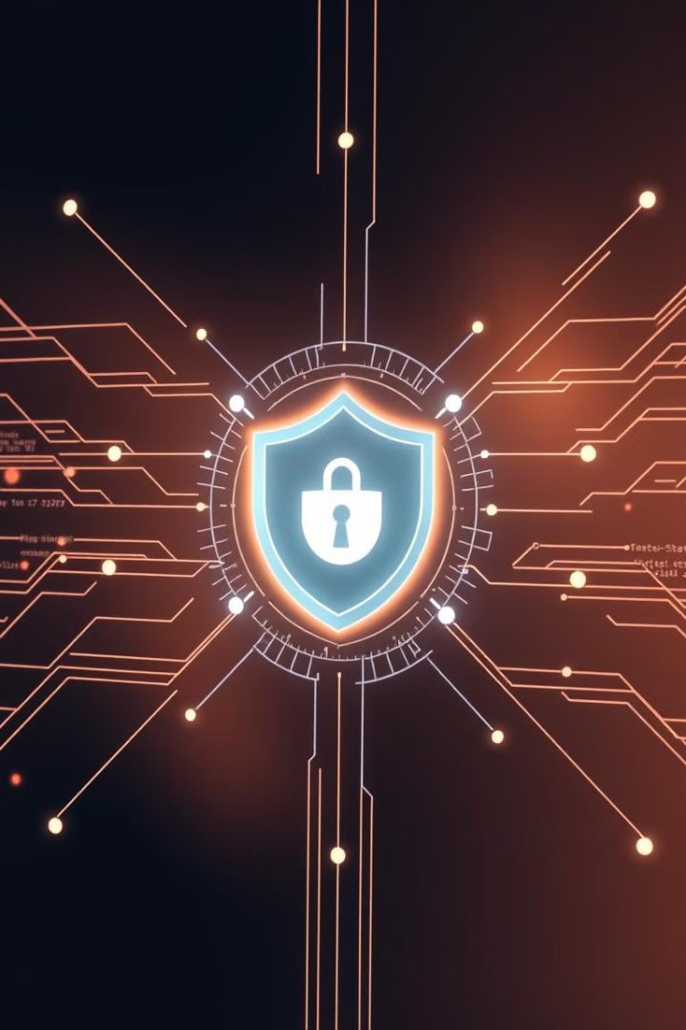
Security Audit and Assessment: Digital Payment Industry
This presentation explores a security audit plan and checklist for the digital payment industry, using PayPal as a reference model. The audit evaluates PayPal's security posture against ISO/IEC 27001, identifying potential nonconformities and recommending improvements.
By: Koo Wai Kit (TP081761)

Slide 2
Table of Contents
1
The Digital Payment Landscape
2
Overview of PayPal
3
Audit Plan: Objectives and Scope
4
Audit Plan: Methodology
5
Sample Security Audit Checklist
6
Nonconformity 1: Third-Party Vendor Management
7
Nonconformity 2: Employee Access Control
8
Nonconformity 3: Data Protection Scope
9
Conclusion

Slide 3
The Digital Payment Landscape
Industry Evolution
Security Challenges
The digital payment industry has undergone rapid evolution, driven by the convenience and efficiency of online platforms. This shift has exposed the industry to sophisticated cyber threats and vulnerabilities.
Robust security measures and thorough security audits are crucial to protect sensitive financial data and secure consumer trust in an increasingly digital economy.

Slide 4

Overview of PayPal
Founded
Business Models
Key Services
December 1998
Online payment platform enabling digital payments and money transfers for individuals and businesses.
Person-to-person money transfers
Merchant services for online retailers
PayPal Credit and Buy Now, Pay Later options
Integration with various e-commerce platforms
Global Reach
User Base
Operates in over 200 markets and supports 25 currencies.
Over 400 million active accounts as of 2024.
Why Perform Security Audits for PayPal?
Security audits for PayPal are essential to protect sensitive data, ensure compliance, manage risks, prevent fraud, enhance customer trust, promote continuous improvement, prepare for incidents, and maintain a competitive edge.

Slide 5
Audit Plan: Objectives and Scope
Objective 1
Objective 2
Objective 3
Objective 4
Evaluate the effectiveness of PayPal’s security controls in safeguarding sensitive financial data.
Assess PayPal’s compliance with industry standard such as ISO/IEC 27001.
Identify technical and procedural weaknesses in PayPal's digital payment processes.
Provide actionable recommendations to enhance security resilience and mitigate fraud risks.
Scope:
Uses PayPal as a reference model to assess the security posture of digital payment systems, focusing on user authentication, data encryption, and transaction integrity while evaluating its compliance with ISO/IEC 27001 as an industry benchmark.

Slide 6
Audit Plan: Methodology
Planning
1
Understand PayPal's operational environment and identify critical information assets, processes, and systems to be evaluated.
2
Document Review
Scrutinize PayPal's ISMS documentation, including policies, procedures, risk assessments, and incident response plans.
Fieldwork
3
Evaluate the effectiveness of ISMS policies and procedures through interviews, observations, and technical testing.
4
Analysis
Analyze collected data to identify nonconformities or areas for improvement, and determine the effectiveness of existing security controls.
Reporting
5
Compile findings into a comprehensive report that documents vulnerabilities, assesses security effectiveness, and provides recommendations for remediation.

Slide 7
Sample Security Audit Checklist
Security Domain
Security Measure
ISO/IEC 27001 Clause
ISO/IEC 27001 Control
Compliance Evidence
Network Security
Monitor and log all network traffic for anomalies
9.1 Monitoring, Measurement, Analysis and Evaluation
A.1.8.16 Monitoring activities
Network monitoring logs, SIEM reports
Identity and Access Management (IAM)
Enforce multi-factor authentication (MFA) for all critical systems
8.3 Information Security Risk Treatment
A.1.8.5 Secure authentication
MFA implementation reports, authentication logs
Application Security
Perform regular security testing, including penetration testing and code reviews
9.1 Monitoring, Measurement, Analysis and Evaluation
A.1.8.29 Security testing in development and acceptance
Penetration test reports, code review logs
Data Security and Encryption
Implement data leakage prevention (DLP) mechanisms
8.3 Information Security Risk Treatment
A.1.8.12 Data leakage prevention
DLP policies, audit logs

Slide 8
Sample Security Audit Checklist: Key Areas
Security Domain
Security Measure
ISO/IEC 27001 Clause
ISO/IEC 27001 Control
Compliance Evidence
Security Monitoring and Incident Response
Monitor and log all security-relevant activities in a centralized SIEM system
9.1 Monitoring, Measurement, Analysis and Evaluation
A.1.8.15 Logging
SIEM logs, security event reports
Business Continuity and Disaster Recovery (BCDR)
Develop and maintain a BCDR plan
8.1 Operational Planning and Control
A.1.5.30 ICT readiness for business continuity
Disaster recovery test results, BCDR documentation
Employee Security Awareness and Physical Security
Ensure all employees undergo security awareness training
7.3 Awareness
A.1.6.3 Information security awareness, education, and training
Training records, employee acknowledgment forms
Compliance and Regulatory Requirements
Ensure compliance with legal, regulatory, and contractual obligations
5.31 Legal, Statutory, Regulatory, and Contractual Requirements
A.1.5.31 Legal, statutory, regulatory, and contractual requirements
Compliance audit reports, regulatory documentation

Slide 9
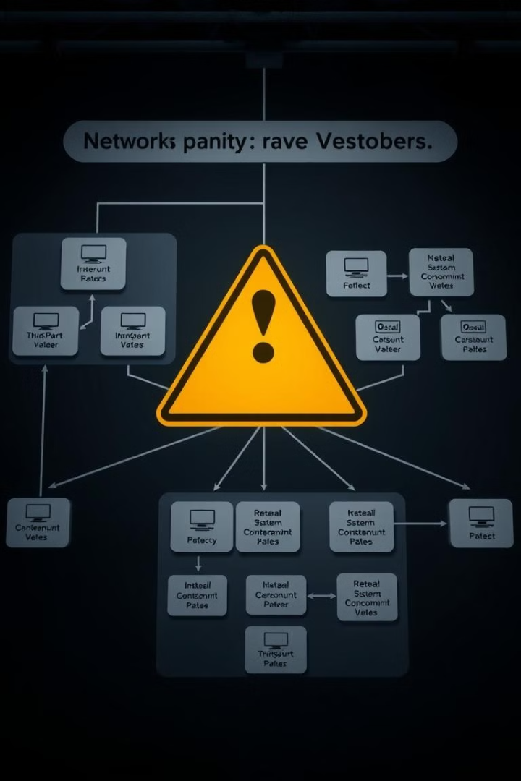
Nonconformity 1: Third-Party Vendor Management
1
Risk
2
Evidence
Inadequate monitoring of third-party vendors and supply chain risks can lead to data breaches or service disruptions.
PayPal acknowledges relying on third-party vendors for goods and services, but the extent of their security engagement with all vendors is unclear.
3
Recommendations
Establish a continuous monitoring program for vendor security compliance, with a risk assessment framework to classify vendors based on data sensitivity.

Slide 10
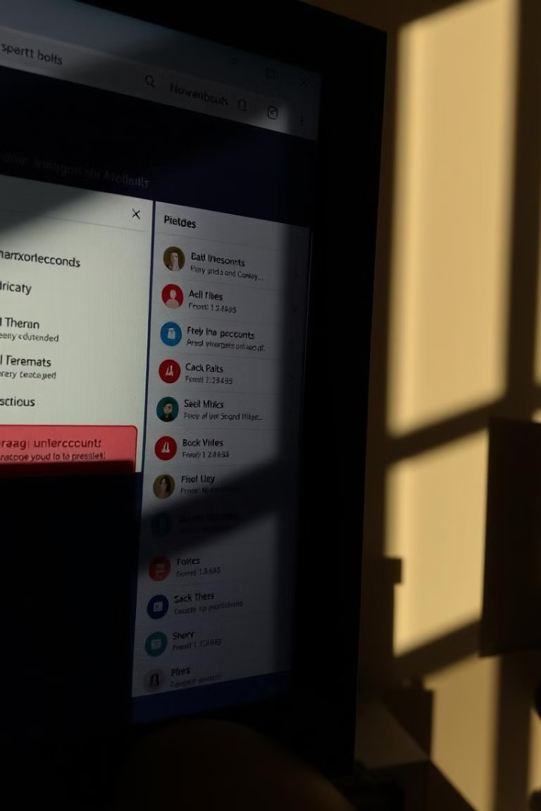
Nonconformity 2: Employee Access Control
1
Risk
2
Evidence
Insufficient controls over employee access and data handling can result in unauthorized access and internal misuse of customer data.
PayPal has policies on employee access control and data handling, but the implementation and enforcement of these policies are unclear.
3
Recommendations
Adopt a zero-trust access model, implement automated user behavior analytics (UBA), and improve endpoint security.

Slide 11

Nonconformity 3: Data Protection Scope
1
Risk
2
Evidence
Limited scope of data protection and privacy assessments for certain services can create vulnerabilities to malicious actors.
PayPal's Privacy Statement excludes certain services, such as Venmo and Hyperwallet, from its data management and privacy program.
3
Recommendations
Make the security and privacy framework applicable to all subsidiaries and services, establish a cross-service data protection policy, and conduct regular risk impact assessments.

Slide 12
Conclusion
1
Third-Party Vendor Management
2
Employee Access Control
3
Data Protection Scope
The audit of PayPal's digital payment system identified weaknesses in vendor risk management, employee access controls, and data protection, highlighting the need for ongoing improvements to strengthen security and comply with global standards, which is essential for building trust in the wider digital payment industry.

